Slide 1
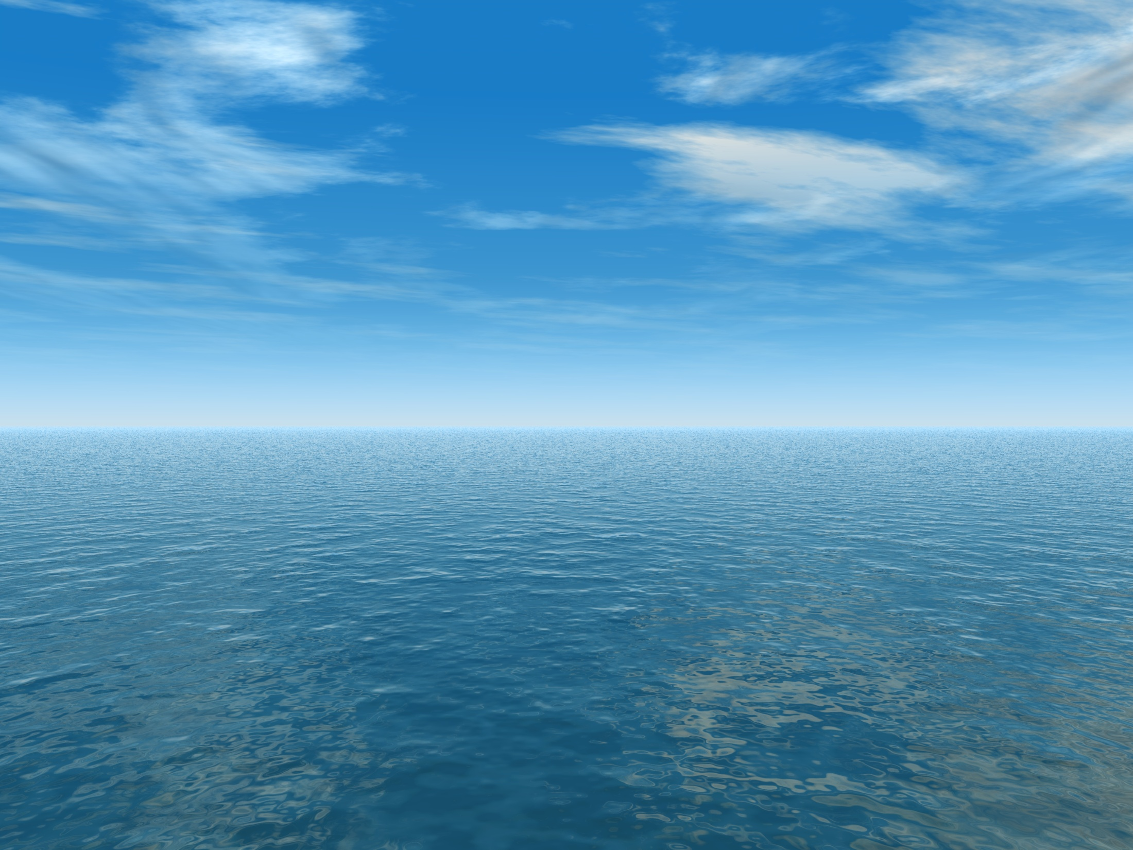
THE AQUANTIS OCEAN-CURRENT TURBINE
RENEWABLE ENERGY FROM MARINE CURRENTS
1/25th Scale Rotor Off-Design
March 28, 2013
Henry Swales
Company Confidential and Proprietary

Slide 2
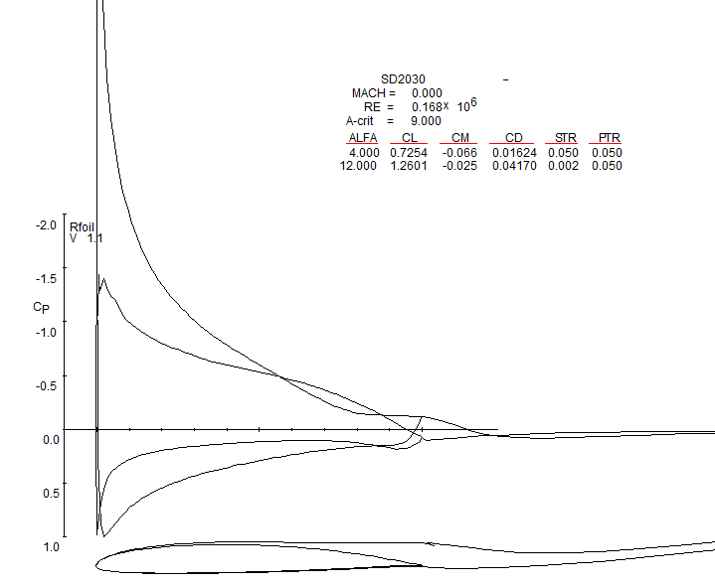
SD2030 Cp Distribution
Operational Cp_{min} >= -1.44
Much smaller than min cavitation number = 4.7
Sheet cavitation not predicted for any operational mode

Slide 3
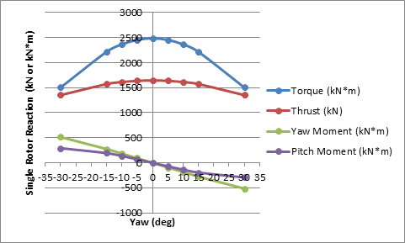
Rotor response to Yaw

Slide 4
Rotational Effects
RFoil
ECN / Delft University

